Slide 1
ICT4 Computer Architecture Experiment MIPS Laboratory

Slide 2
Overview
I. Introduction to MIPS
II. MIPS programming model
III. MIPSIT user guide

Slide 3
I. Introduction to MIPS
MIPS (originally an acronym for Microprocessor without Interlocked Pipeline Stages)
MIPS is a RISC (Reduced Instruction Set Computer) instruction set architecture (ISA) developed by MIPS Technologies (formerly MIPS Computer Systems, Inc.)
In 1981, a team led by John L. Hennessy at Stanford University started work on what would become the first MIPS processor.
Multiple revisions of the MIPS instruction set exist, including MIPS I, MIPS II, MIPS III, MIPS IV, MIPS V, MIPS32, and MIPS64.
http://en.wikipedia.org/wiki/MIPS_architecture

Slide 4
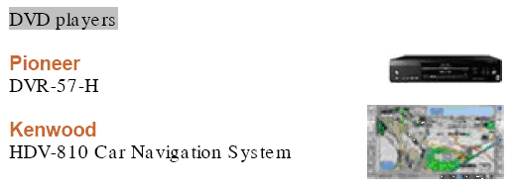

Applications of MIPS processor

Slide 5
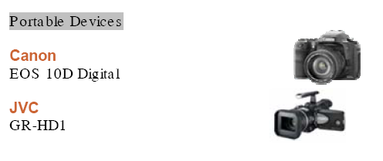
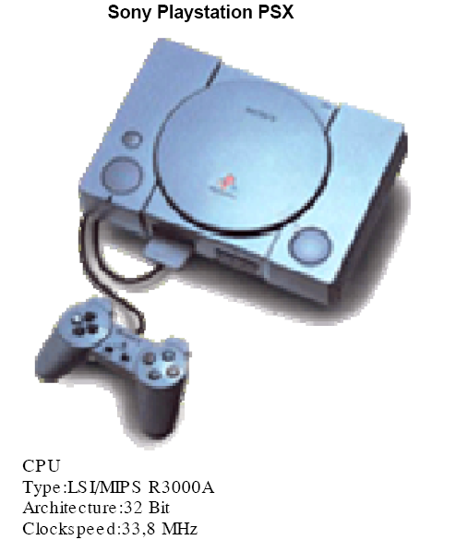

Applications of MIPS processor

Slide 6
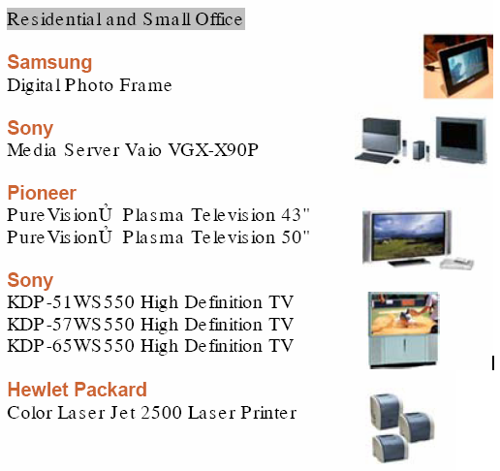
Applications of MIPS processor

Slide 7
II. MIPS Programming Model
Data Types
Registers
Instruction Formats
MIPS Instruction
Addressing Mode
MIPS Assembly program
MIPSIT

Slide 8
Data Types
Byte = 8 bits
Used only for floating-point data, so safe to ignore in this course
Halfword = 2 bytes
Word = 4 bytes
Doubleword = 8 bytes
Quadword (16 bytes) also used occasionally
MiniMIPS registers hold 32-bit (4-byte) words. Other common data sizes include byte, halfword, and doubleword.

Slide 9
Register Conventions
Figure 5.2 Registers and data sizes in MiniMIPS.

Slide 10
Instruction Formats
A typical instruction for MiniMIPS and steps in its execution.

Slide 11
MiniMIPS Instruction Formats
Figure 5.4 MiniMIPS instructions come in only three formats: register (R), immediate (I), and jump (J).

Slide 12
Simple Arithmetic/Logic Instructions
Add and subtract already discussed; logical instructions are similar
add $t0,$s0,$s1 # set $t0 to ($s0)+($s1)
sub $t0,$s0,$s1 # set $t0 to ($s0)-($s1)
and $t0,$s0,$s1 # set $t0 to ($s0)∧($s1)
or $t0,$s0,$s1 # set $t0 to ($s0)∨($s1)
xor $t0,$s0,$s1 # set $t0 to ($s0)⊕($s1)
nor $t0,$s0,$s1 # set $t0 to (($s0)∨($s1))′
Figure 5.5 The arithmetic instructions add and sub have a format that is common to all two-operand ALU instructions. For these, the fn field specifies the arithmetic/logic operation to be performed.

Slide 13
Arithmetic/Logic with One Immediate Operand
An operand in the range [−32 768, 32 767], or [0x0000, 0xffff], can be specified in the immediate field.
addi $t0,$s0,61 # set $t0 to ($s0)+61
andi $t0,$s0,61 # set $t0 to ($s0)∧61
ori $t0,$s0,61 # set $t0 to ($s0)∨61
xori $t0,$s0,0x00ff # set $t0 to ($s0)⊕ 0x00ff
For arithmetic instructions, the immediate operand is sign-extended
1 0
Errors
0 1
Figure 5.6 Instructions such as addi allow us to perform an arithmetic or logic operation for which one operand is a small constant.

Slide 14
Load and Store Instructions
lw $t0,40($s3)
lw $t0,A($s3)
MiniMIPS lw and sw instructions and their memory addressing convention that allows for simple access to array elements via a base address and an offset (offset = 4i leads us to the i th word).

Slide 15
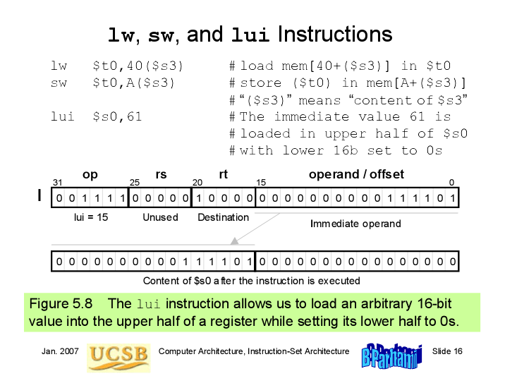

Slide 16
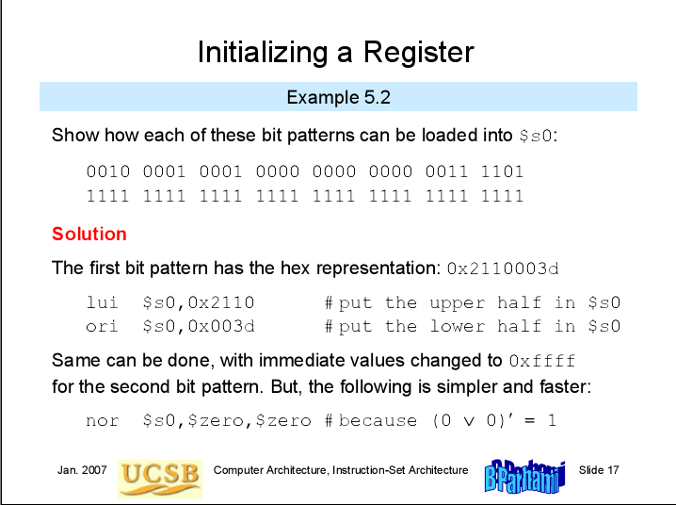

Slide 17
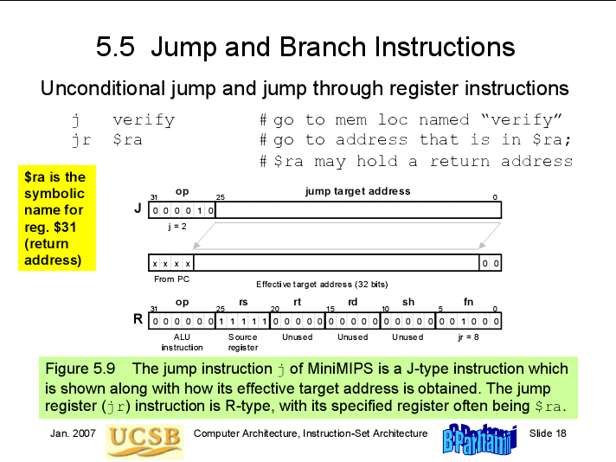

Slide 18
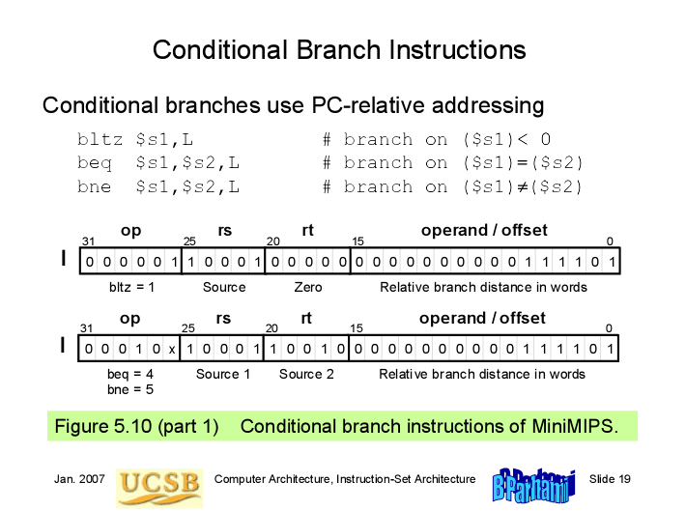

Slide 19
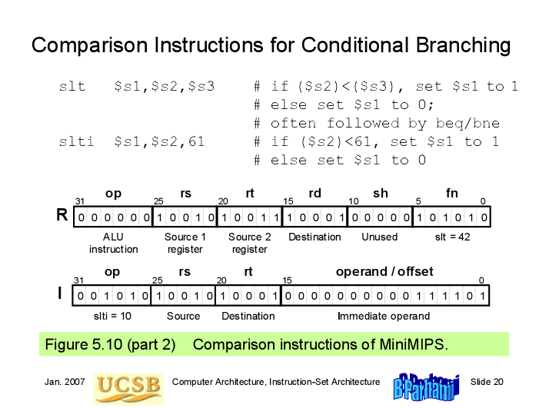

Slide 20
Examples for Conditional Branching
If the branch target is too far to be reachable with a 16-bit offset
(rare occurrence), the assembler automatically replaces the branch
instruction beq $s1,$s2,L1 with:
bne $s1,$s2,L2 # skip jump if (s1)≠(s2)
j L1 # goto L1 if (s1)=(s2)
L2: ...
Forming if-then constructs; e.g., if (i == j) x = x + y
bne $s1,$s2,endif # branch on i≠j
add $t1,$t1,$t2 # execute the “then” part
endif: ...
If the condition were (i < j), we would change the first line to:
slt $t0,$s1,$s2 # set $t0 to 1 if i<j
beq $t0,$0,endif # branch if ($t0)=0;
# i.e., i not< j or i≥j

Slide 21
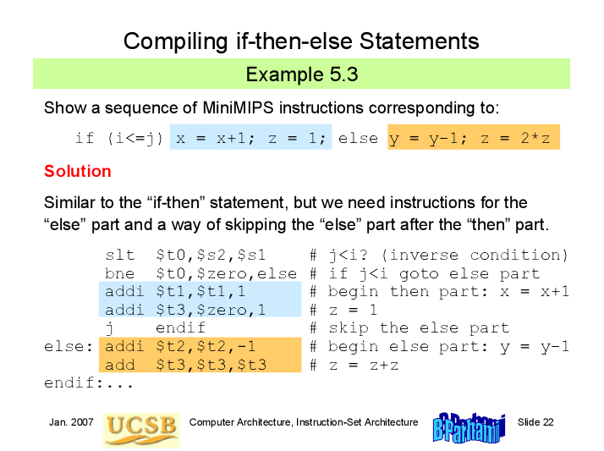

Slide 22
while Statements
Example
The simple while loop: while (A[i]==k) i=i+1;
Assuming that: i, A, k are stored in $s1,$s2,$s3
Solution
loop: add $t1,$s1,$s1 # t1 = 4*i
add $t1,$t1,$t1 #
add $t1,$t1,$s2 # t1 = A + 4*i
lw $t0,0($t1) # t0 = A[i]
bne $t0,$s3,endwhl #
addi $s1,$s1,1 #
j loop #
endwhl: … #

Slide 23
switch Statements
Example
The simple switch
beq s1,t0,case_0
beq s1,t1,case_1
beq s1,t2,case_2
b default
case_0:
addi s2,s2,1 #a=a+1
b continue
case_1:
sub s2,s2,t1 #a=a-1
b continue
case_2:
add s3,s3,s3 #b=2*b
b continue
default:
continue:
switch(test) {
case 0:
a=a+1; break;
case 1:
a=a-1; break;
case 2:
b=2*b; break;
default:
}
Assuming that: test,a,b are
stored in $s1,$s2,$s3

Slide 24
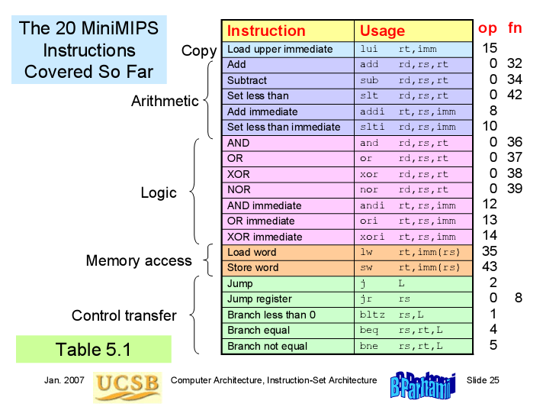

Slide 25
Pseudoinstructions
Pseudoinstructions means “fake instruction”
Pseudoinstructions do not correspond to real MIPS instructions
The assembler, that converts assembly language programs to machine code, would then translate pseudoinstructions to real instructions, usually requiring at least one on more instructions.
Example:
mov $rt, $rs #Copy contents of register s to register t, R[t] = R[s]
=> real instruction: addi $rt, $rs, 0
Notes:
Pseudoinstructions not only make it easier to program, it can also add clarity to the program, by making the intention of the programmer more clear

Slide 26
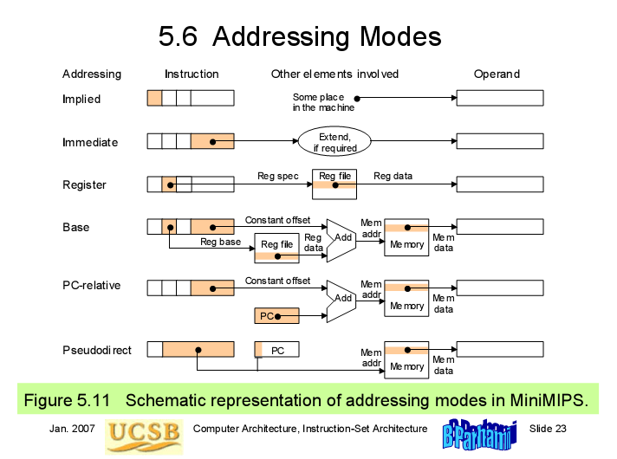

Slide 27
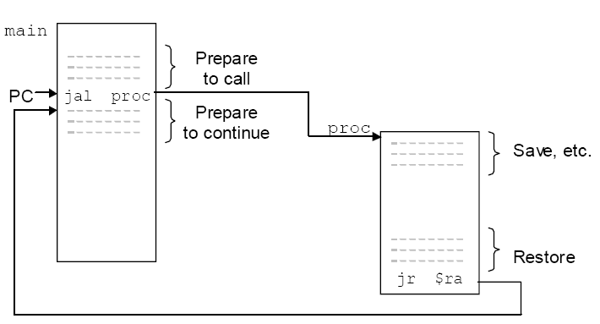
Procedure & Stack
Procedure call:
jal ( jump and link)
Return to call point
jr $ra

Slide 28
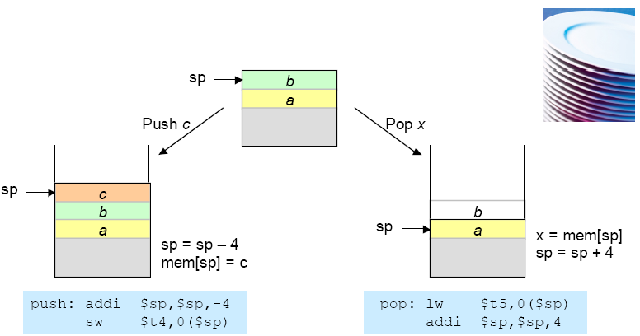
Stack

Slide 29
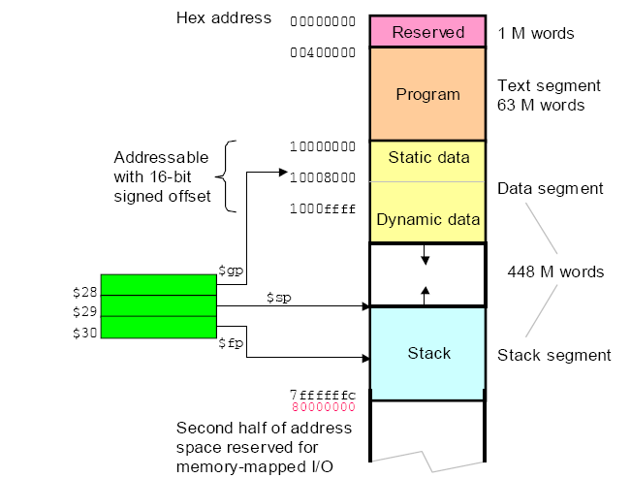
Stack

Slide 30
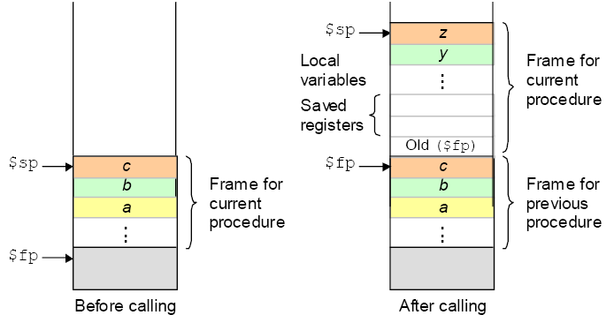
$sp and $fp

Slide 31
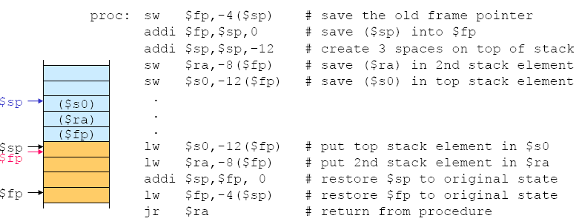
Example: $sp and $fp

Slide 32
III. MIPSIT User Guide
MIPSIT IDE + MIPS Simulator
MIPS assembly program

Slide 33
Instroduce to MIPSIT Studio
MIPSIT Studio: a tool to edit, compile and simulate programs based on MIPS instruction set.

Slide 34
Installation
Extract MipsIt.rar to installed folder, “C:\MipsIt” for example. After this step, MipsIt folder will have following structure:
MipsIt\bin: include execution files, such as
MipsIt.exe: an editor and compiler program
Mips.exe: a simulator program
MipsPipeS.exe: a simple pipeline simulator program
MipsPipeXL.exe: a more complicated pipeline simulator program
…
MipsIt\include: include header files
MipsIt\lib: include library files
…

Slide 35
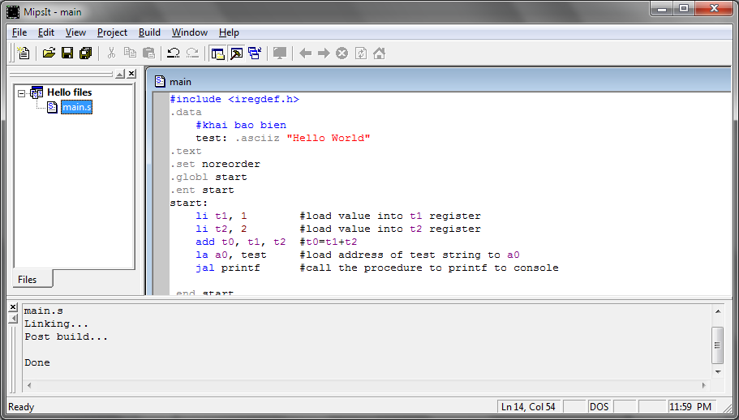
IDE Basics

Slide 36
IDE Basics
Files list
Editor
Compile, Build
Upload to Simulator

Slide 37
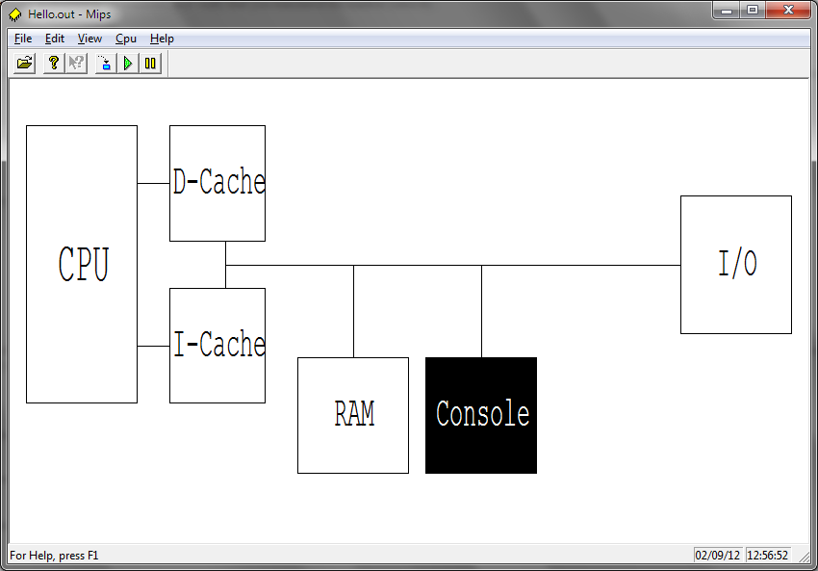
The Simulator
MIPS.exe

Slide 38
The Simulator
CPU View/modify the CPU registers. RAM View/modify memory, also referred to as the MemView. This unit has most functions of all, for a more detailed description see below. Console Standard input/output for programs that use it. I/O Simulates the 8-bit I/O unit, with 8 switches and 8 LEDs. D-Cache/I-Cache Views of the data and instruction caches. Interrupt Simulates the interrupt unit, with buttons K1, K2 and the timer.

Slide 39
MIPSIT & MIPS
MIPSIT
UPLOAD
MIPS

Slide 40
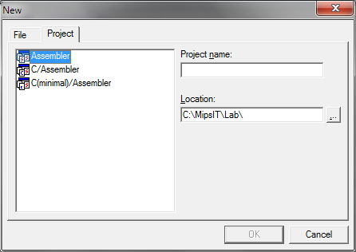
New project
Add files

Slide 41
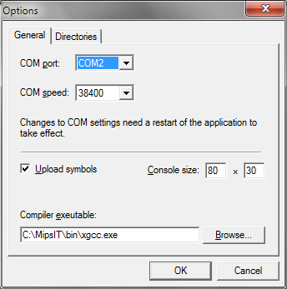
Chú ý: lỗi compile
Kiểm tra File/Option
Mục Compiler executable
Trỏ đến $Root\MipsIT\bin\xgcc.exe
(Không chứa dấu cách)

Slide 42
MIPS assembly program
#include <iregdef.h>
.data
#declare variables
.text
.globl start
.ent start
start:
#main
.end start
.ent CTCon
CTCon:
#procedure
.end CTCon

Slide 43
Example: Hello World
#include <iregdef.h>
.data
test: .asciiz "Hello World"
.text
.set noreorder
.globl start
.ent start
start:
la a0,test #load the address of test string to a0
jal printf #print test tring to console
.end start

Slide 44
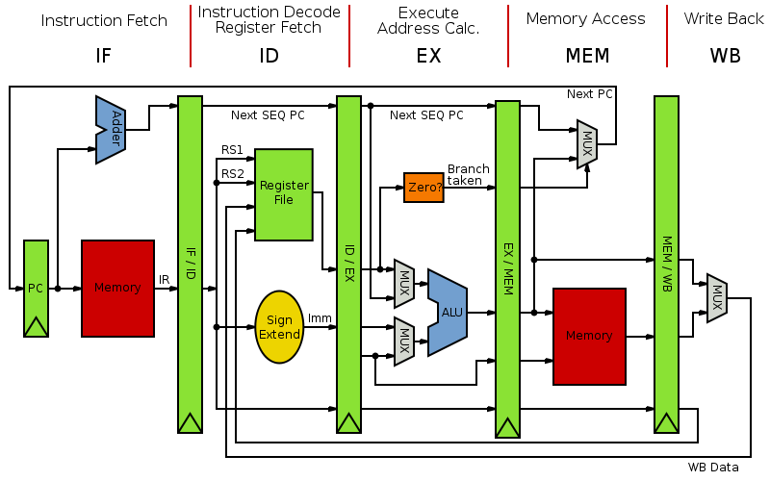
Pipelined MIPS

Slide 45
Lab 3. Arithmetic & Logical Operation
Bit mask in logical operation
li s0,0x0563 #load test value for these function
s0 =
0 | 0 | 0 | 0 | 0 | 0 | 0 | 0 | 0 | 0 | 0 | 0 | 0 | 0 | 0 | 0 | 0 | 0 | 0 | 0 | 0 | 1 | 0 | 1 | 0 | 1 | 1 | 0 | 0 | 0 | 1 | 1
andi t0,s0,0xff #Extract the LSB of s0
MASK
0 | 0 | 0 | 0 | 0 | 0 | 0 | 0 | 0 | 0 | 0 | 0 | 0 | 0 | 0 | 0 | 0 | 0 | 0 | 0 | 0 | 0 | 0 | 0 | 1 | 1 | 1 | 1 | 1 | 1 | 1 | 1
t0 =
0 | 0 | 0 | 0 | 0 | 0 | 0 | 0 | 0 | 0 | 0 | 0 | 0 | 0 | 0 | 0 | 0 | 0 | 0 | 0 | 0 | 0 | 0 | 0 | 0 | 1 | 1 | 0 | 0 | 0 | 1 | 1

Slide 46
Lab 3. Arithmetic & Logical Operation
t0 = 0
s3=s1+s2
Check overflow
s1 xor s2 < 0
TRUE
FALSE
s1 < 0
s3 < s1
FALSE
FALSE
TRUE
TRUE
s3 < s1
FALSE
t0 = 1
Overflow
TRUE
EXIT:
No Overflow

Slide 47
Lab 4. Procedure Calls, Assigment 4. n! (stack with n=3)
$ra(0)
$a0(0) = 3
$fp(0)
…..
$ra(1)
$a0(1) = 2
$fp(1)
$ra(0)
$a0(0) = 3
$fp(0)
…..
$ra(2)
$a0(2) = 1
$fp(2)
$ra(1)
$a0(1) = 2
$fp(1)
$ra(0)
$a0(0) = 3
$fp(0)
…..
$sp(3) ->
$fp(3) ->
$sp(2) ->
$sp(2) ->
$fp(2) ->
$fp(2) ->
$sp(1) ->
$sp(1) ->
$sp(1) ->
$fp(1) ->
$fp(1) ->
$fp(1) ->
$sp(0) ->
$sp(0) ->
$sp(0) ->
$fp(0) ->
$fp(0) ->
$fp(0) ->
Lần gọi 1 (a0=3)
Lần gọi 2 (a0=2)
Lần gọi 3 (a0=1)

Slide 48
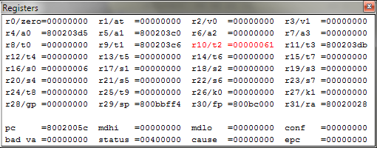
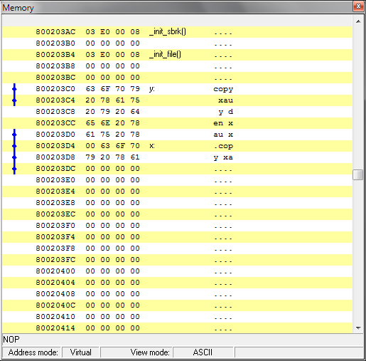
Lab 5. Character string
Địa chỉ xâu y:
a1 = 800203c0
strcpy
s0=6, x[6]=y[6]
Ký tự ‘a’
Địa chỉ xâu x:
a0 = 800203d5
L1:
add t1,s0,a1 #address of y[i] in t1
lb t2,0(t1) #t2=y[i]
add t3,s0,a0 #address of x[i] in t3
sb t2,0(t3) #x[i]=y[i]
beq t2,zero,L2 #if y[i]==0, go to L2
nop
addi s0,s0,1 #i=i+1
j L1 #go to L1
nop
L2:
s0=6, x[6]=y[6]
Ký tự ‘a’
Gõ trực tiếp ngăn nhớ giá trị địa chỉ muốn xem. ví dụ: 800203c0 (xâu y)

